Slide 1
Portraits de famille
Instructions: in your group, pick one person from the picture and describe what they’re wearing. See how quickly others can guess who your person is!

Slide 2
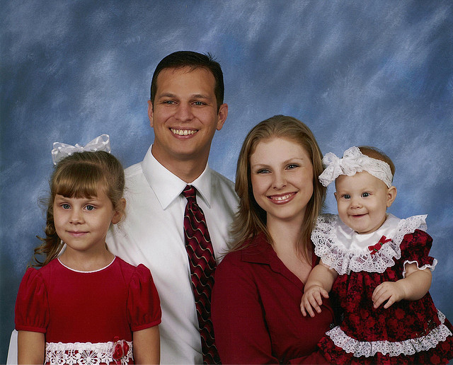
ss
Studio family portrait
Photo credit: Brandon Kunefke. CC BY-NC-ND.

Slide 3
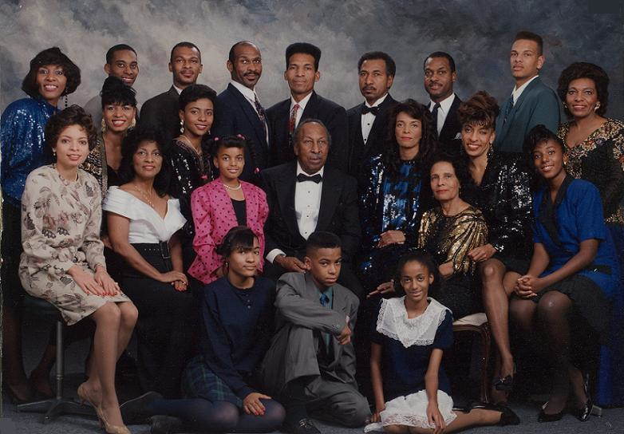
Studio portrait of a large, multigenerational family.
Source: http://emmalkingfoundation.org/home/?page_id=683

Slide 4
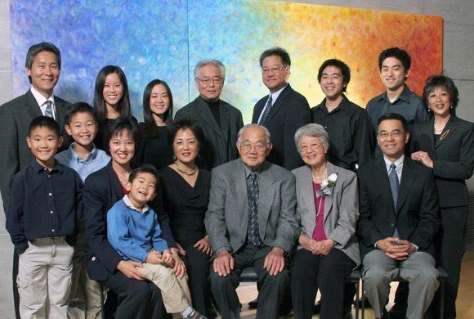
Studio portrait of a large, multigenerational family.
Source: http://www.csupomona.edu/~jsmio/

